Slide 1

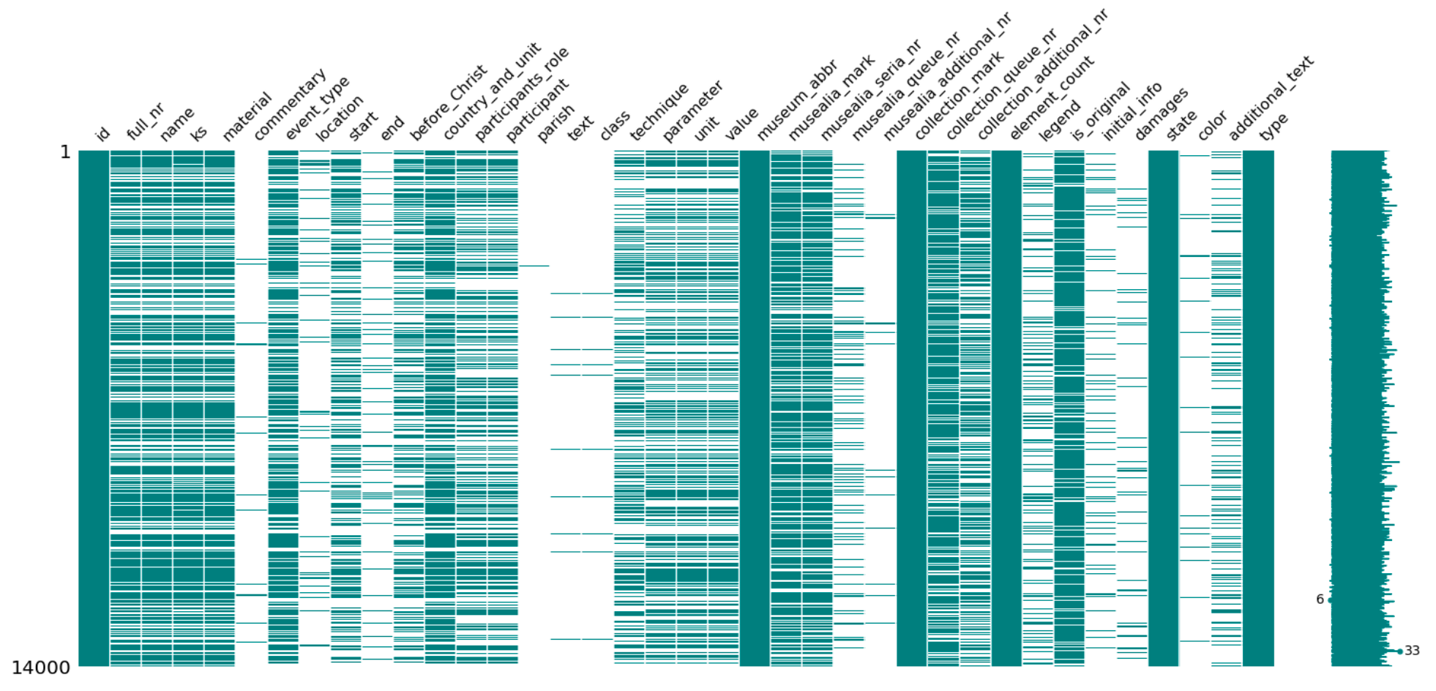
D19: KAGGLE-MUSEUM
Siim Tänavots, Anett Alamets, Siim Pähn
Introduction
There are 4 million objects in the MuIS information system that need to be labelled. Manually this would take years to do and cost tens of thousands of euros in wages and other expenses. While not guaranteeing 100% accuracy due to human mistakes.
2.Objective
The goal of this project is to create a model to predict the type of the museum object based on its descriptive variables and reduce the work of museum staff. Saving hundreds of hours or manual work and thereby saving money for the museums.
3.Methodology
We started by analysing the data and and deleting all the unnecessary data that we wouldn’t need or couldn’t use. This was achieved by looking at what data was available where were the gaps and what correlations existed. After that we had to convert all the data that was left to string and implement our model.
4. Results
Trying different methods to get results proved to be more difficult than we thought at first. Many of the solutions tried did not work as intended or gave incorrect answers. Until the use of DesicionTreeClassifier that gave us quite good accuracy.
5.Analysis
Training the DTC model gave us quite good accuracy that seemed to work through manual checks of the output and when comparing the results.
6. Conclusion
Although we didn't reach as high of an accuracy score as we would have wanted to the current work is a good base to further analysis and improvements. Even with the current accuracy it would save hundreds of hours of manual work.
7. Misc
We also tried to do image classification where we got the model working but had a hard time scraping the data. Confirming one of our risk that the image data would not be as easily accessible as we though before. Due to a lack of time we weren’t able to get the data required to get that extra part of the task working.
Source code:

